Slide 1

Natural Gas Pipelines
Strong Growth Opportunities in All Markets Served
Steady Earnings Growth
Predictable Net Cash Contribution to Enron
Rate Case Certainty
Near Term Expansions in High Growth Markets
  Florida Expanding to 2.1 Bcf/d by 2002
  Transwestern Expanding Capacity to California
  Northern Natural Bolstered by Increased Gas-Fired Plant Demand
Significant Future Growth Opportunities Serving New Gas-Fired Generation
Northern Border Partners (11%)
Northern Natural (100%)
Transwestern (100%)
Florida Gas (50%)
Transports 15% of U.S. Gas Demand; Peak Capacity of 10.8 Bcf/day

Slide 2
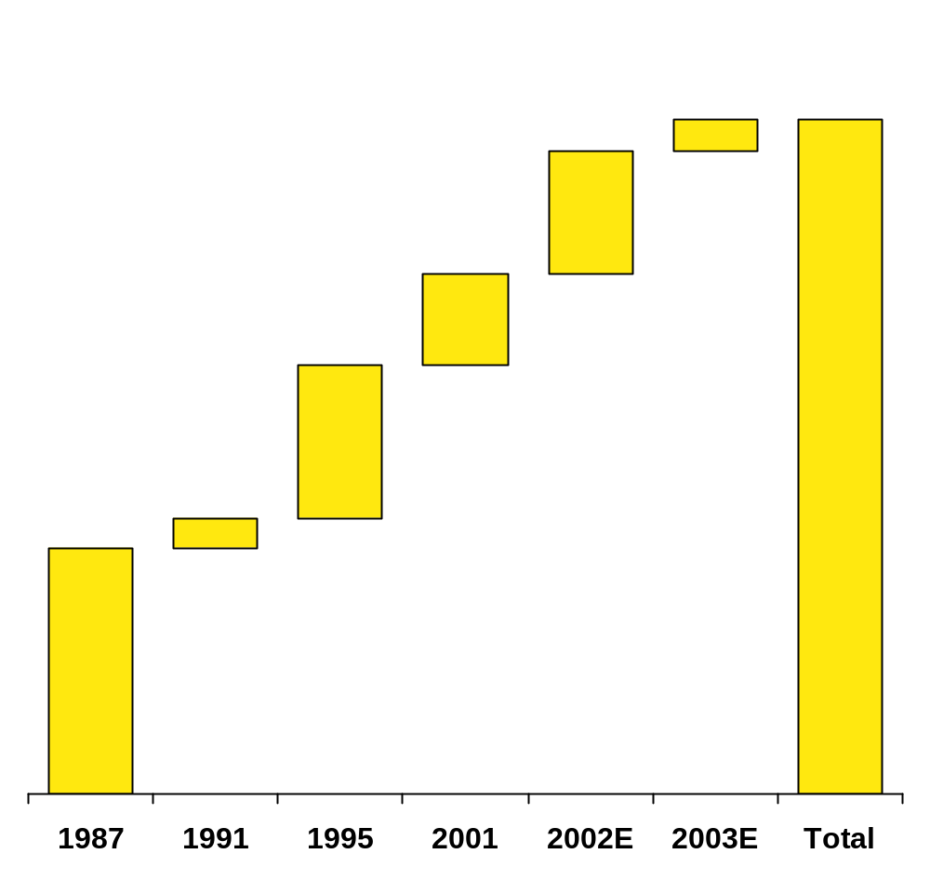
Florida Gas Expansion Activity
Capacity
(Bcf/d)
Third Party
Power Plants
0.1
2.2
Pipe
0.4
Existing
Phase IV
Phase V
2001
2002
0.3
2003
Ft. Myers
0.5
Major Pipeline Expansions Underway
New Demand-Driven Expansion Opportunities
  Over 15,000 MW of New Generation Proposed in Florida Through 2003
Evaluating Supply Connections to Proposed LNG Facilities
Capacity
(MMcf/d)
Cost
(Millions)
Contract Term
(Years)
Expected
In-Service
0.1
0.8
Phase V 428 $460 20 April 2002
Phase VI 120 $80-100 20 Mid 2003
Phase I
Phase II
Phase III
Phase IV
Phase V
Phase VI
09_01_3rd Quarter_DRAFT 10-11 -<number>
Notes:
Over the last decade, the FGT system has doubled in size.
FGT has won regulatory treatment that has allowed expansions with staggered in-service dates. This means that we are always adding just enough capacity to match market growth. This has been key to maintaining our competitive edge.
In 2000, FGT began gas service to Fort Myers, a market previously not served by natural gas.
In May, 2001, FGT placed in-service the Phase IV expansion.
We received final FERC approvals in late July to construct our Phase V expansion. This project is due to be in-service by 2003.
Together, Phase IV, V, VI will add about 700 million cubic feet per day of new capacity by 4th quarter, 2003. More important, these expansions are secured by firm long-term contracts.
Gulfstream has started construction on their pipeline to enter the Florida market. Before now, FGT was the only gas pipeline in peninsular Florida. This means that FGT will have to remain competitive and efficient to attract new customers and beat the competition.

Slide 3

Transwestern Expansion Activity
Colorado
Red Rock – 150 MMcf/d Expansion in Growing Arizona Market; Approved by FERC
Recent Interconnections Completed to Serve Gas-Fired Generation
Utah
San Juan
Basin
Kansas
Anadarko
Basin
Arizona
Oklahoma
New Mexico
Permian
Basin
Texas
Transwestern Pipeline
Interconnects
Red Rock
Supply and Demand-Based Expansion Opportunities
Notes:
I am certain all of you have heard about California’s energy woes.
Just in time to have new capacity entering the California market, Transwestern expanded the mainline by 140 MMcf/d last year.
Transwestern recently received approval from FERC to install new compression at four existing stations in Arizona to expand its system by 150 MMcf/d of incremental firm capacity. TW’s total capacity to the California border will increase to 1.24 Bcf/d. The $93 million project is expected to be in service by June, 2002.
Additionally, last year, Transwestern added connections into several key new markets in Arizona and Nevada. These new connects make it more attractive for shippers to enter long-term contracts with Transwestern, as they will now have the ability to drop off gas in Arizona, Nevada or California markets.
Transwestern has bi-directional flow capabilities and provides flexibility to rapidly adapt to the regional demand.
The western deliveries are fully subscribed through December 2005 and eastern deliveries are fully subscribed through 2002. We are well positioned for recontracting.

